Slide 1
Community Service Project
MENTOR TRAINING - DAY 4

Slide 2
Welcome | 10 | 90 | 10:00 am - 11:30 am
Warm up activity | 15
Recap | 15
Agenda | 5
Types of Research Methods and approaches | 45
Break | 15 |  | 11:30 - 11:45 am
Data collection methods | 30 | 90 | 11:45 am - 1:15 pm
Survey Research | 60
Lunch Break | 60 |  | 1:15pm - 2:15pm
Warm up activity | 20 | 90 | 2:15 pm - 3:45 pm
Introduction to types/methods of data collection | 45
Look at a case study- Identifying which are 3 best methods for collection of data | 25

Slide 3
Break | 15 |  | 3:45pm - 4:00 pm
Share a sample questionnaire of the case and identify missing questions | 20 | 90 | 4:00 pm - 5:30 pm
Different ways of collecting data | 10
Introduction to increasing participant engagement. Some points to keep in mind | 30
Explain week 1 and 2 of student curriculum | 20
Recall | 10

Slide 4
Session 1
90 mins
Welcome
Warm up
Recap
Agenda
Research Methods and Approaches

Slide 5
Welcome
Welcome to Day 4 of the Mentors Training Session
Reminder to fill in Day 3 feedback form

Slide 6
How are your energy levels?
1
5

Slide 7
Energiser (optional)
Let’s get you know you all a little better
Introduce yourselves in the following format
2 mins to think of responses
Once done put it in the chat box or unmute and share
Hi My name is ______________, I would like be a ______________ in the kitchen because I am ____________ just like the _______
For eg: My name is Asha and I would like to be a spoon in the kitchen because I am multitasker just like the spoon

Slide 8
Recap (Comment on chat…)
What did we do in the Day 3 of the training sessions?

Slide 9
Summarize
Why You and Why are you here?
Your Expectations of the program
8 weeks of the program for the students
Experience a section of the student curriculum
*Identifying issues around us through observation and experience
* Shortlisting problems
*Mapping it to SDGs
* Problem tree analysis, Framing the problem statement and research question
Introduction to who is a guide and guide actions

Slide 10
Agenda
Go through Second half of the week 1 curriculum
Types of Research & Survey Methods
Identifying Key Stakeholders for your survey
Introduction to tools for data collection
Identify key questions and tools for data collection
Guide Actions
Look at topics for Week 1 and 2 of student curriculum

Slide 11
Let’s do an activity
https://forms.gle/Pc3cGd3YVSMoGpbm8
Click on the link
Share in your responses
10 mins to respond
Time’s Up

Slide 12
What do you think happened now? (Comment on chat…)
https://forms.gle/Pc3cGd3YVSMoGpbm8
Respond by unmuting or using the chat box
This was an example of a survey around the teachers who are a part of this training and their demographic. With the data received we got to know a few things.

Slide 13
What are the things you see in this analysis (Comment on chat…)
https://forms.gle/Pc3cGd3YVSMoGpbm8
This was a sample of an online survey, we will be going in depth about research and surveys today
Let’s take a look at the data received
https://docs.google.com/forms/d/1f0ACcE5pqaoILCyH2K_GYM2IEiNyyJAQgEUZ18w9qiA/edit#responses
Take 3 mins and note down What are some of your findings

Slide 14
Thank you this was fun :)

Slide 15
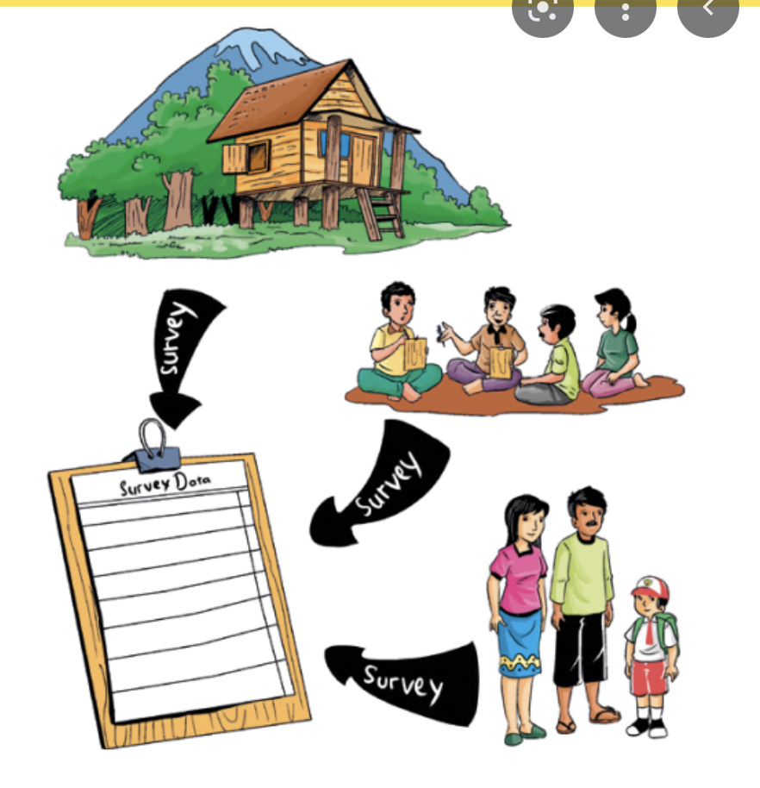
Socio Economic Survey
A socio-economic survey is regarded as one of the most important sources of statistical data on household expenditure and income as well as other data on the status of housing, individual and household characteristics and living conditions.
Factors include: occupation, education, income, wealth and where someone lives
Socio-economic survey tools are designed to collect information as a means of improving understanding of local resource management systems, resource use and the relative importance of resources for households and villages
Students survey work will be accounted as socio-economic data to aid community development and growth.

Slide 16
Socio Economic Surveys as Secondary Research:
The National Sample Survey Office (NSSO) conducts nationwide sample surveys relating to various socio-economic topics to collect data for planning and policy formulation.
They are in the form of Rounds
Each Round being normally of one-year duration and occasionally for a period of six months.
In this cycle - 1 year is devoted to Land and Livestock Holdings, Debt and Investment
1 year to Social Consumption (education, health care, etc.)
2 years to quinquennial (every 5 years) surveys on household consumer expenditure, employment & unemployment situation
4 years to non-agricultural enterprises, namely, manufacturing, trade and services in the unorganized sector.
Last 2 years are for open Rounds in which subjects of current/special interest on the demand of Central Ministries, State Governments and research organizations are covered.
The Government of India along with NITI Aayog, State Governments and other ministries publish various report across different sectors measuring various aspects.

Slide 17
● NHFS Survey
● Economic Survey
● State wide Socio Economic Survey
● Census
● Good Governance Report
● NITI Aayog Innovation Index
● NITI Aayog SDG Index
● Multidimensional Poverty Index
Students can choose relevant reports from these places as per their Research question to combine their findings from primary research to present a detailed analysis and recommendation.

Slide 18
Week 1 - Socio Economic Survey (Village/Habituation)
What a problem is and how to identify a problem
Identify Problem Through Observations and Experiences , problem statement and research question

Slide 19
Research and Survey
Insight of what problems people have in our habituation/ village / town
Research and understand what is happening.
In this section
Go through different research methods
Might already know
Observe and give feedback on the methods

Slide 20
Research Method
Community-based participatory research (CBPR)
Research method is a specific set of procedures for answering your research questions by collecting and analyzing data. It involves making decisions about the type of data you need and the methods you’ll use to collect and analyze it.
Community-based participatory research is a collaborative research approach that involves all partnerships in the research process and recognize the unique strength that each brings.

Slide 21
Community members
Instituitions
Affected individuals
Problems
Private
industries
Panchayat members
Local bodies

Slide 22
Benefits of CBPR
Enhances community relevance of research questions
Facilitates effective dissemination of findings to impact public health & policy
Strengthens interventions within cultural and local context
Enhances reliability/validity and of measurement tools
Increases accurate and culturally sensitive interpretation of findings
Increases research trust
1
2
3
4
5
6
It will be most beneficial if our students use this methodology for their project work for a buy-in from the community. To understand CBPR further - Let’slook at this video.

Slide 23
Case Study of CBPR
Objective: To study the effect of a community-based health education intervention on awareness and behaviour change of rural adolescent girls regarding their management of menstrual hygiene.
Materials and methods: A participatory-action study was undertaken in Primary Health Centres in 23 villages in Anji, in the Wardha district of Maharashtra state. Study subjects were unmarried rural adolescent girls (12-19 years). A needs assessment study conducted for health messages with this target audience, using a triangulated research design of quantitative (survey) and qualitative (focus group discussions) methods.
Program for Appropriate Technology for Health (PATH) guidelines were used to develop a pre-tested, handmade flip book containing needs-based key messages about the management of menstrual hygiene. The messages were delivered at monthly meetings of village-based groups of adolescent girls, called Kishori Panchayat. After 3 years, the effect of the messages was assessed using a combination of quantitative (survey) and qualitative (trend analysis) methods.

Slide 24
Results: After 3 years, significantly more adolescent girls (55%) were aware of menstruation before its initiation compared with baseline (35%). The practice of using ready-made pads increased significantly from 5% to 25% and reuse of cloth declined from 85% to 57%. The trend analysis showed that adolescent girls perceived a positive change in their behaviour and level of awareness.
Conclusion: The present community health education intervention strategy could bring significant changes in the awareness and behaviour of rural adolescent girls regarding management of their menstrual hygiene.
For a complete preview of the above CBPR research study, check out this link.

Slide 25
Students Research
The student/s could conduct a survey of the habitation, if necessary, in terms of their own domain or subject area.

Slide 26
Examples
Sciences
could take up a survey on the health and hygiene conditions of that habitation
Arts
will focus on socio-economic conditions, social survey and about the Government’s social security schemes
04
01
03
Other Streams
Similar topics related to their subject
General Survey
incorporating all the different areas.
02
NOTE
A common survey format could be designed. This should not be viewed as a duplication of work by the Village or Ward volunteers; rather, it could be another primary source of data.

Slide 27
Students research method should be driven by their aims and priorities - they start by thinking carefully about what they want to achieve. When planning your their methods, there are two key decisions they will make.
A) Qualitative vs. quantitative: Will your data take the form of words or numbers?
B) Primary vs. secondary: Will you collect original data yourself, or will you use data that has already been collected by someone else?
C) Descriptive vs. experimental: Will you take measurements of something as it is, or will you perform an experiment?
For quantitative data, you can use statistical analysis methods to test relationships between variables.
For qualitative data, you can use methods such as thematic analysis to interpret patterns and meanings in the data.
COLLECT DATA
ANALYSE

Slide 28
Qualitative
vs.
Quantitative
Deals with numbers and statistics | Deals with words and meanings.
Understand subjective experiences, beliefs, and concepts | Measure variables and describe frequencies, averages, and correlations
Gain in-depth knowledge of a specific context or culture | Test hypotheses about relationships between variables
Explore under-researched problems and generate new ideas | Test the effectiveness of a new treatment, program or product
NOTE
Both are important for gaining different kinds of knowledge.

Slide 29
Guess?
An organization that conducts an event, collecting feedback from the event attendees about the value that they see from the event. Collect actionable feedback about the satisfaction levels of customers during various phases of the event such as the sales, pre and post-event, the likelihood of recommending the organization to their friends and colleagues, hotel preferences for the future events and other such questions.
Qualitative

Slide 30
Guess?
You can use this type of research to measure learning outcomes like grades, test scores for online classes
Quantitative

Slide 31
Guess?
Survey conducted to understand the amount of time a doctor takes to tend to a patient when the patient walks into the hospital. Other questions on how much time a doctor takes to see a patient, how often a patient walks into a hospital can be asked to know the patient satisfaction levels
Quantitative

Slide 32
Guess?
You can use this type of research to find exactly what teachers and students struggle with online classes.
Qualitative

Slide 33
Primary
Secondary
vs.
Original information that you collect for the purposes of answering your research question (e.g. through surveys, observations and experiments | Information that has already been collected by other researchers (e.g. in a government census or previous scientific studies).
If you are using a new research question, you need to collect primary data.
To synthesize existing knowledge, analyze historical trends, or identify patterns on a large scale, secondary data might be a better choice.
Usually, both can be combined as part of the research method. This is where getting the community involved will be helpful
NOTE

Slide 34
Descriptive
Experimental
vs.
In descriptive research, you collect data about your study subject without intervening. The validity of your research will depend on your sampling method. This includes observations, surveys, existing case studies etc | In experimental research, you systematically intervene in a process and measure the outcome. The validity of your research will depend on your experimental design. This includes experiments in the laboratory for example

Slide 35
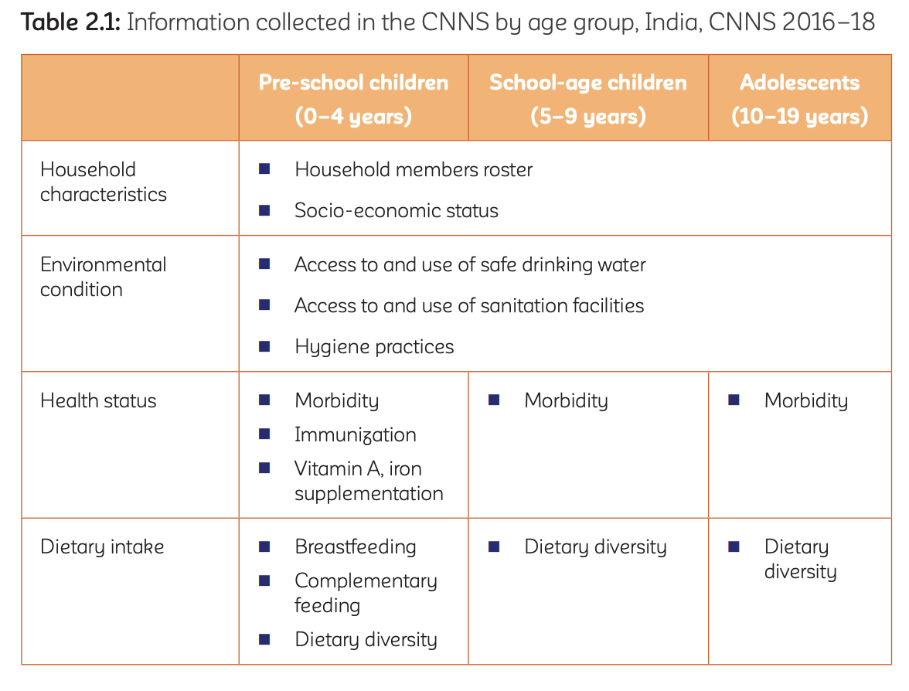
Sample
Now, let us look at an example study conducted by the Ministry of Health - the ‘Comprehensive National Nutrition Survey’ (CNNS) to collect a comprehensive set of data on nutritional status of Indian children from 0–19 years of age
Qualitative

Slide 36
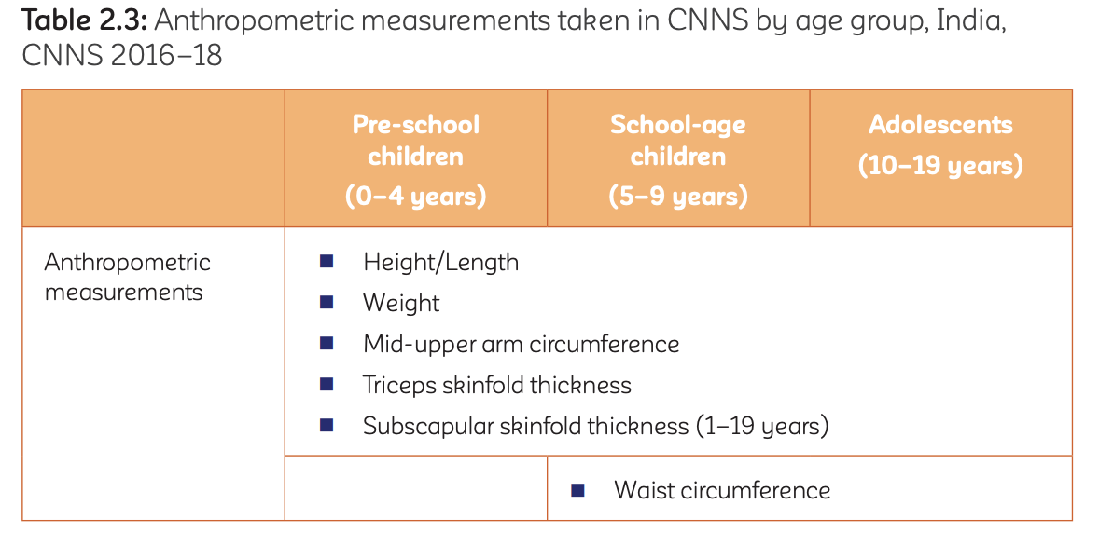
Sample
Quantitative
*Anthropometric = scientific study of the measurements and proportions of the human body

Slide 37
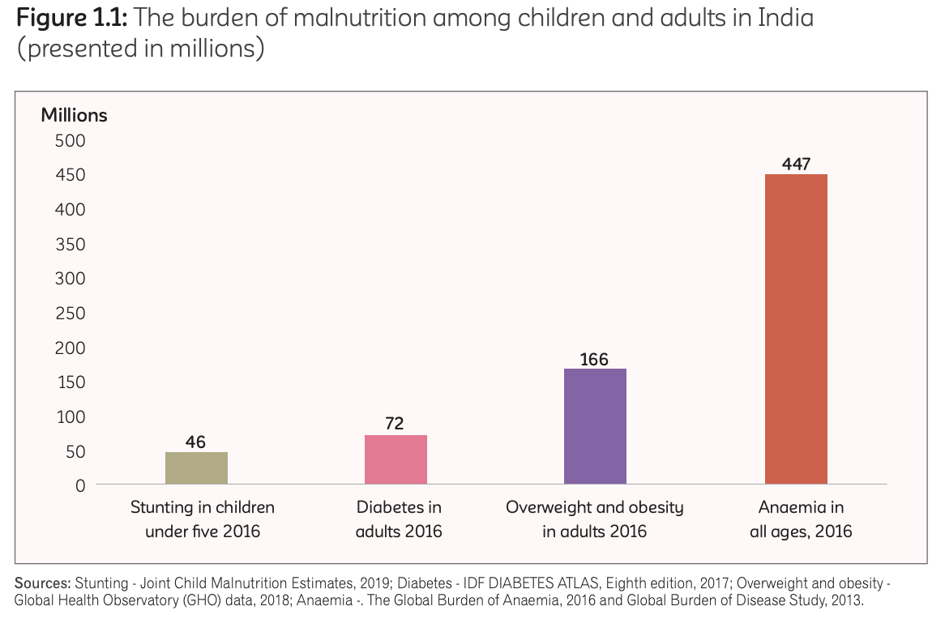
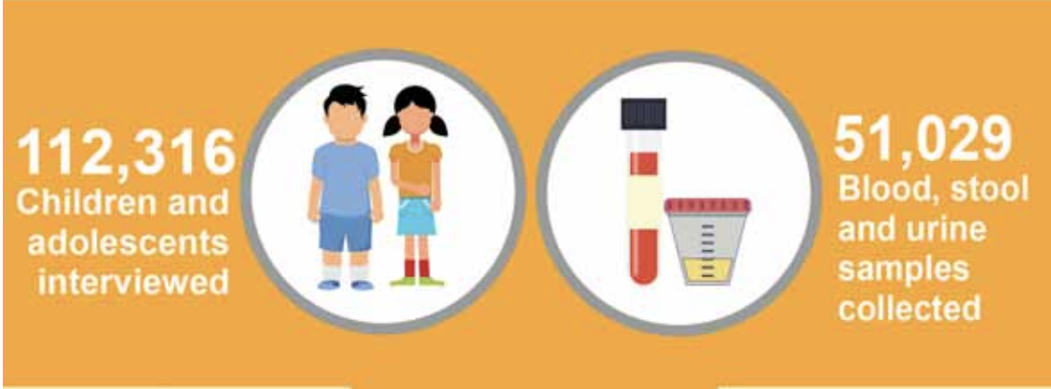
Sample
Primary
Secondary
NOTE
This study was a mixed method that involved usage of primary data collection as shown above and included existing secondary sources of data

Slide 38
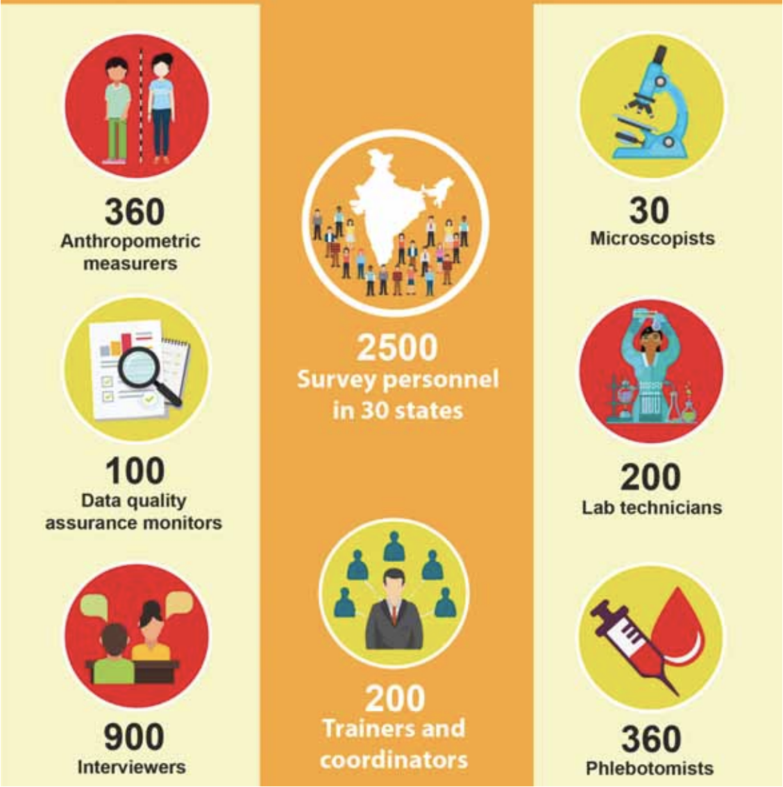
Sample
The above study used both descriptive and experimental methods. As shown in the Qualitative and Quantitative method, the data collected was descriptive i.e data was collected as is without any external change introduced - Descriptive
Simultaneously, as shown in the image - blood, urine and stool samples were collected that included a team of microscopists, lab technicians to conduct detailed experiments to analyze micro data on the survey participants - Experimental

Slide 39
BREAK
15 MINS

Slide 40
Session 2
90 mins
Data collection Methods
Survey research
Importance of Key Stakeholders and how to identify them

Slide 41
Observations: Observing subjects in a natural environment where variables can’t be controlled.
Surveys: List of closed or multiple choice questions that is distributed to a sample (online, in person, or over the phone).
Quantitative data collection methods
Experiments: Situation in which variables are controlled and manipulated to establish cause-and-effect relationships.

Slide 42
Literature review:
Survey of published works by other authors.
Interviews:
Asking open-ended questions verbally to respondents. Key informant interviews can also be conducted: qualitative in-depth interviews with people who know what is going on in the community.
Qualitative data collection methods
Ethnography:
Participating in a community or organization for an extended period of time to closely observe culture and behavior.
Focus groups:
Discussion among a group of people about a topic to gather opinions that can be used for further research.

Slide 43
Qualitative Data Collection
+
Quantitative Data Collection

Slide 44
Qualitative Data Collection
More complete picture of the problem you’re studying and strengthen the credibility of your conclusions.
For this project, students are expected to use ‘Surveys’ and ‘Interviews’ as the primary methods of data collection. By nature of this program’s design ‘Observations’, and ‘Ethnography’ are integrated as part of the process.
NOTE
Quantitative Data Collection

Slide 45
Sample where both are used
https://bmcpublichealth.biomedcentral.com/articles/10.1186/s12889-017-4706-9
Background
A multi pronged community based strategy, known as National Rural Health Mission (NRHM), was implemented from 2005–06 to 2012–13 in India
Aim was to curtail maternal and child health (MCH) disparities between poor and rich, rural and urban areas, and boys and girls,.
This study aimed to determine the degree to which MCH plans of NRHM implemented, and resulted in improving the MCH outcomes and reducing the inequalities.

Slide 46
Methods
mixed methods study was conducted
first to assess the degree of implementation of MCH plans by estimating the budget utilization rates of each MCH plan, and the effectiveness of these plans by comparing demographic health surveys data conducted post (2012–13), during (2007–08) and pre- (2002–04) NRHM implementation period, in the quantitative study.
Then, perceptions and beliefs of stakeholders regarding extent and effectiveness of NRHM in Haryana were explored in the qualitative study during 2013.

Slide 47
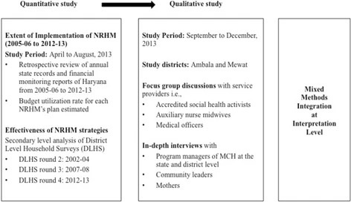

Slide 48
Survey Research
This project students are expected to do Surveys.
Survey research means collecting information about a group of people by asking them questions and analyzing the results. To conduct an effective survey, follow these four steps:
Determine who will participate in the survey - define population and sample
Decide the type of survey (In-person or Online)
Design the survey questions and layout
Distribute the survey

Slide 49
STEP 1: Determine who will participate in the survey - define population and sample
Before conducting survey research
First have a clear research question that defines the hypothesis
Based on the research question, Determine exactly who you will target to participate in the survey.
( Target Audience or Key Stakeholder) - are the specific groups of people that you want to find out about
This group can be very broad or relatively narrow.
Survey a sample from the population.
The sample should aim to be a representative of the population as a whole.
The larger and more representative your sample, the more valid your conclusions
NOTE

Slide 50
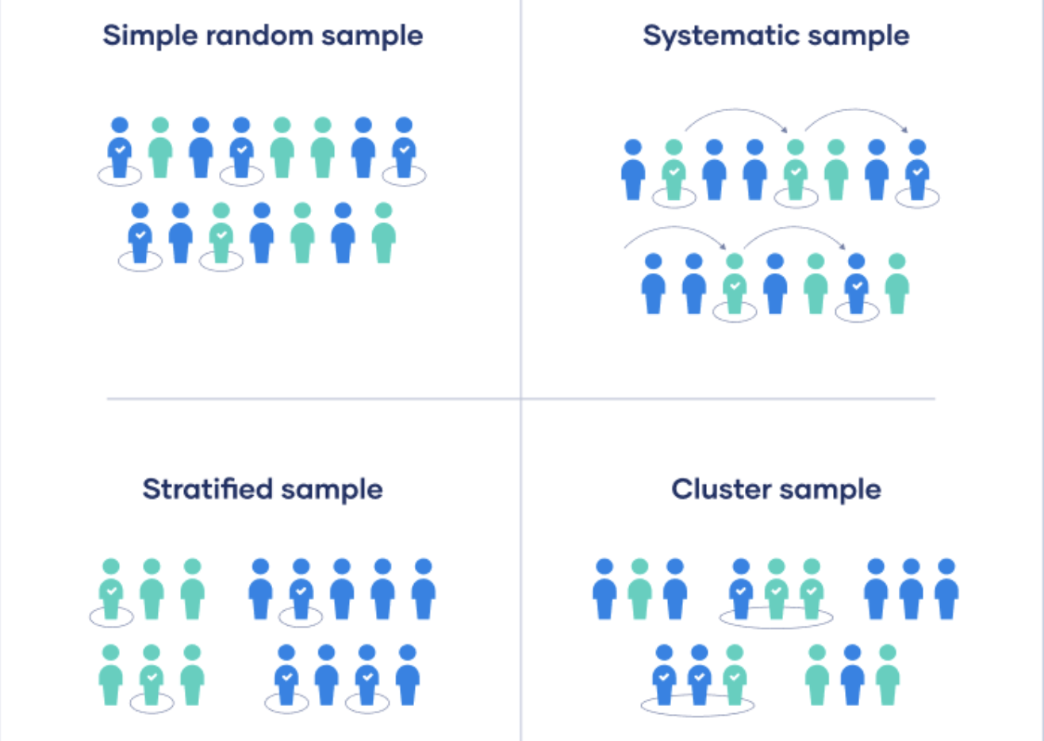
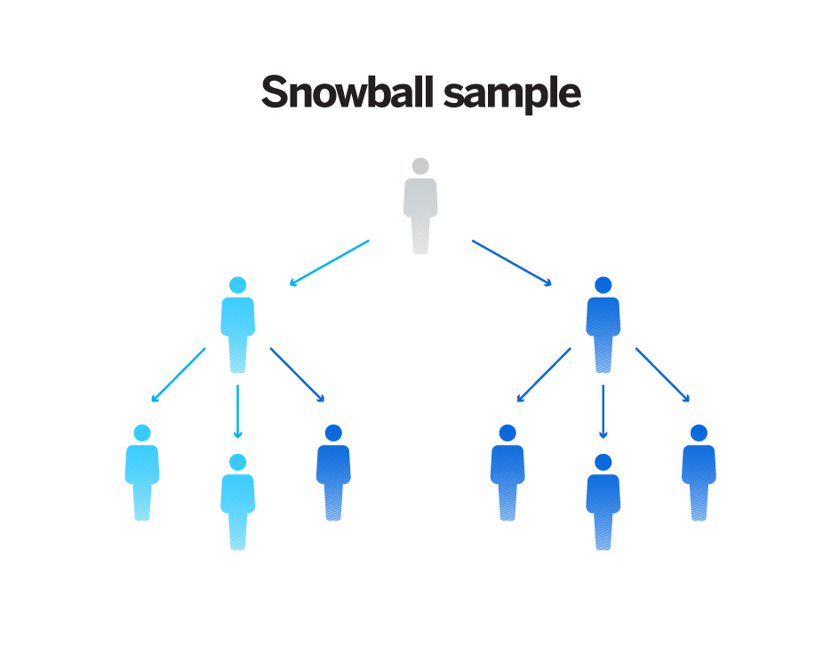
It is Impossible to survey the entire population of your research.
Sampling methodology is used for conducting research

Slide 51
Key Stakeholders
During research survey
Different types of survey methods for different stakeholders
For eg if you are looking to find out why students are dropping out of school
Your stakeholders involved will be students, teachers, parents and school authorities.
Survey with the students
In person interview with parents and teachers
Collect data from school authorities

Slide 52
Case 1
Collaborative ecosystem based land use planning?
To ensure that the land in village x is used sustainably, avoiding negative impacts or threats from environmental degradation and forest loss while ensuring that the social and economic considerations of all users are accounted for.
Question: if a survey needs to be done to ensure land in the village is used sustainably
Who all should be included in the survey
What type of survey should be done

Slide 53
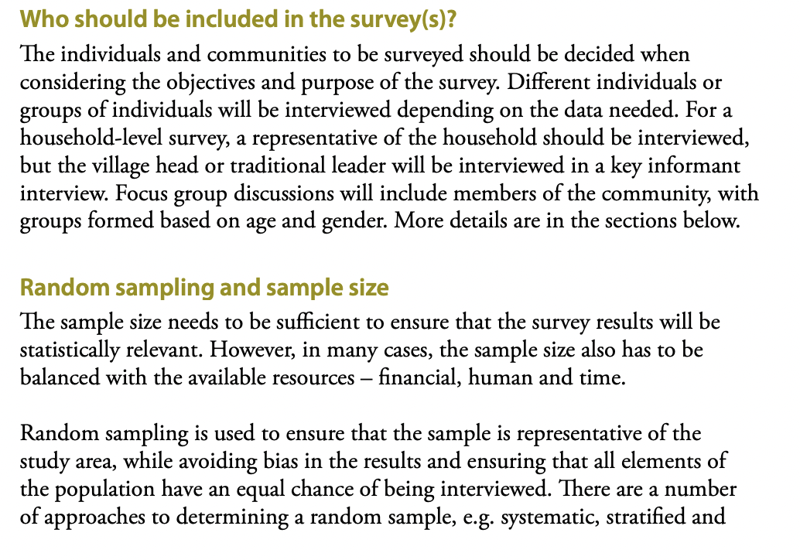

Slide 54
Case 2
The rise of agribusiness has impacted the agricultural sector worldwide. Specifically in India, many small farmers have been negatively affected by the rise of agribusiness, as they are competing against large farms that have access to more resources and money. In recent decades, alternative food networks (AFNs) have arisen, generally as small-scale, non-governmental programs that provide a way for small farmers to find success and receive fair compensation for their crops. This study focuses on small farmers who participate in an AFN, specifically a farmer producer company (FPC) referred to as Sahaja Aharam, based in Hyderabad within the Indian state of Telangana.
Question: Who are the key stakeholders involved here
Sahaja Aharam members, farmers who participated in AFN program and the ones who did not participate
Agriculture department members

Slide 55
BREAK
60 MINS

Slide 56
Session 3
90 mins
Types of survey and the tools used
Identify which tool suits the research

Slide 57
Warm Up Activity
If you were given a wand to find out answers to 3 questions in life what would that be?
For eg I want to find an answer to the what happened to the mysterious Malaysian airlines missing
Did you understand?
Great you have 5 mins to write it down in your book
Now think of how you will get that answer
Who will you go ask and how?
Thank you
Link Students

Slide 58
Survey Research
This project students are expected to do Surveys.
Survey research means collecting information about a group of people by asking them questions and analyzing the results. To conduct an effective survey, follow these four steps:
Determine who will participate in the survey - define population and sample
Decide the type of survey (In-person or Online)
Design the survey questions and layout
Distribute the survey

Slide 59
STEP 2: Decide the type of survey
There are two main types of survey you can use during this project, which type you choose depends on the sample size, location and your research question.
Questionnaire
Interviews
Online Questionnaire
In-Person Questionnaire
Focus Group
Key Informants

Slide 60
Questionnaires
A list of questions is distributed online or in-person, and respondents fill it out themselves.

Slide 61
In Person
- Research focuses on a specific location - Distribute a written questionnaire - Spot collection
For example, you could approach the customers at a local grocery store or members at the panchayat office or students to complete a questionnaire at the end of a class.
People in the target population are included in the sample.
You can collect time- and location-specific data (e.g. the opinions of a store’s weekday customers).
Online
- popular choice for students doing research - low cost and flexible - Large sample - No constraints on time or location. - The data is easy to process and analyze. - Online tools ( SurveyMonkey and Google Forms. )

Slide 62
Interviews
Asks a set of questions by phone or in person and records the responses.
Oral interviews are a useful method for smaller sample sizes.
Gather more in-depth information on people’s opinions and preferences.
Advantages
You have personal contact with respondents, so you know exactly who will be included in the sample in advance.
You can clarify questions and ask for follow-up information when necessary.
The lack of anonymity may cause respondents to answer less honestly, and there is more risk of researcher bias.
NOTE

Slide 63
Focus Group Interviews
A small group of people to answer questions in a moderated setting.
Chosen due to predefined demographic traits
Questions are designed to shed light on a topic of interest.
Type of qualitative research
Natural feedback than individual interviews
Easier to organize than experiments or large-scale surveys.

Slide 64
A focus group may be a good choice for you if:
You’re interested in real-time, unfiltered responses on a given topic or in the dynamics of a discussion between participants
Your questions are rooted in feelings or perceptions, and cannot easily be answered with “yes” or “no”
You’re confident that a relatively small number of responses will answer your question
You’re seeking directional information that will help you uncover hidden issues

Slide 65
Key Informant Interviews
Qualitative in-depth interviews with people who know what is going on in the community.
The purpose is to collect information from a wide range of people
Community leaders, professionals, or residents
Who have first hand knowledge about the community or issue

Slide 66
Like questionnaires, interviews can be used to collect quantitative data:
-The researcher records each response as a category or rating and statistically analyzes the results.
-But they are more commonly used to collect qualitative data: the interviewees’ full responses are transcribed and analyzed individually to gain a richer understanding of their opinions and feelings.
(Transcribing is converting speech to text word for word, a common practice when conducting interviews)

Slide 67
Data Collection
There are different ways in which we can collect data.
For eg record interviews on a phone
Similarly think of all the different ways in which you can collect data for all the types of survey.
5 mins to make an exhaustive list

Slide 68
Questionnaire (Online and In-person)
Interviews
(Calls and In-person)
Look at these categories and add in which type of tool will be useful for collecting data for that particular survey -

Slide 69
BREAK
15 MINS

Slide 70
Session 4
90 mins
Designing survey questions
Guide actions - Introduction to participant engagement and check for understanding
Recall
Closing

Slide 71
Survey Research
This project students are expected to do Surveys.
Survey research means collecting information about a group of people by asking them questions and analyzing the results. To conduct an effective survey, follow these four steps:
Determine who will participate in the survey - define population and sample
Decide the type of survey (In-person or Online)
Design the survey questions and layout
Distribute the survey

Slide 72
STEP 3: Design survey questions and layout
To decide which questions you will ask and how you will ask them. It’s important to consider:
1
2
3
4
Type of Questions
The Content of the Questions
Phrasing the survey questions
The ordering and layout of the questions

Slide 73
1
Type of Questions
Open-ended and closed-ended
Many surveys use a combination of both.

Slide 74
Close Ended Questions
Closed-ended questions give the respondent a predetermined set of answers to choose from. A closed-ended question can include:
A binary answer (e.g. yes/no or agree/disagree) Are you satisfied with the current work-from-home policies?
A scale (e.g. a scale with five points ranging from strongly agree to strongly disagree)
Example: Do you agree or disagree that the government should be responsible for providing clean drinking water and high-speed internet to everyone?
Strongly Agree
Agree
Undecided
Disagree
Strongly Disagree

Slide 75
A list of options with a single answer possible (e.g. age categories)
Example: What is your age?
15 or younger
16–35
36–60
61–75
76 or older
Best for quantitative research.
Provide you with numerical data that can be statistically analyzed to find patterns, trends, and correlations.
NOTE

Slide 76
Open Ended Questions
Open questions are most common in interviews
You can also use them in questionnaires.
Useful as follow-up questions to ask for more detailed explanations of responses to the closed questions.
Examples:
How do you feel about the sanitation system in your area?
How would you describe your personality?
In your opinion, what is the biggest problem you face living in XYZ location?

Slide 77
Open-ended questions are best for qualitative research.
This type of question has no predetermined answers to choose from.
Instead, the respondent answers in their own words.
NOTE

Slide 78
2
The Content of the Questions
To ensure the validity and reliability of your results, you need to carefully consider each question in the survey.
All questions should be narrowly focused with enough context for the respondent to answer accurately.
Avoid questions that are not directly relevant to the survey’s purpose.
When constructing closed-ended questions, ensure that the options cover all possibilities. If you include a list of options that isn’t exhaustive, you can add another field.

Slide 79
3
Phrasing the survey questions
In terms of language, the survey questions should be as clear and precise as possible.
Tailor the questions to your target population, keeping in mind their level of knowledge of the topic.
Use language that respondents will easily understand, and avoid words with vague or ambiguous meanings.
Make sure your questions are phrased neutrally, with no bias towards one answer or another.

Slide 80
4
The ordering and layout of the questions
The questions should be arranged in a logical order.
Start with easy, non-sensitive, closed-ended questions that will encourage the respondent to continue.
If the survey covers several different topics or themes, group together related questions.
You can divide a questionnaire into sections to help respondents understand what is being asked in each part.
If a question refers back to or depends on the answer to a previous question, they should be placed directly next to one another.

Slide 81
Survey Research
This project students are expected to do Surveys.
Survey research means collecting information about a group of people by asking them questions and analyzing the results. To conduct an effective survey, follow these four steps:
Determine who will participate in the survey - define population and sample
Decide the type of survey (In-person or Online)
Design the survey questions and layout
Distribute the survey

Slide 82
STEP 4: Distribute the survey
Before you start, create a clear plan for where, when, how, and with whom you will conduct the survey.
Determine in advance how many responses you require
How you will gain access to the sample.

Slide 83
Sample Questionnaire
We will now go through a questionnaire and look at what elements are missing
You have 5 mins to skim through it
Now mention the missing elements in the chat box
https://docs.google.com/document/d/1v33v_7BJkDWX7VqfS39lYf28ItXEd_HxsjRn_c06cVY/edit?usp=sharing

Slide 84
Actual survey
The actual survey:
https://docs.google.com/document/d/14IioP4WIH6xYXMrA3KHfzwZ3yFHYKjvi/edit?usp=sharing&ouid=106125956927223881781&rtpof=true&sd=true

Slide 85
Mentor Actions(Comment on chat…)
What do you think is the most important mark of a good project?
Respond in chat
A project will be effective only when students have worked on it with interest and have had the maximum learning.

Slide 86
Mentor Actions(Comment on chat…)
How would we know if the participants have really worked on the project and are on track?
Respond in chat

Slide 87
Mentor Actions - Participant Engagement
(Comment on chat…)
What are some of the things you do/best practices you take to ensure max participation from?

Slide 88
Mentor Actions - Check for Progress (Comment on chat…)
What are some of the things you do/best practices you do for checking for student progress?

Slide 89
Mentor Actions - Participant Engagement
Encourage - all opinions, thoughts and ideas are welcome, even if they are different from others, There is freedom to fail and learn.
Decentralize learning - If mentees come with a problem to you instead of immediately solving it for them, push them to think of answers and make them do the start and address then address the problem
Motivate them - Push them to give their best - share resources which you think will help them. Motivate them with examples and push them to give their best

Slide 90
Mentor Actions - Check for progress
Ask Questions/Probe - when checking on their progress ask them deeper questions. If they say they have completed survey ask them who all have they spoken to, what was their experience
Set up a time to get weekly updates - give responsibility to the mentees by asking them to set up a weekly review call. Club 2 mentees to check each other progress ( can think of more innovative ideas like these)

Slide 91
Week 1 and 2 - Student Curriculum

Slide 92
Week 1 and 2 - Socio Economic survey of the Village/Habitation
Identifying problems through their personal observations and experiences
Speaking to their friends and family to see if they face similar issues ( mini survey)
Shortlisting top 5 issues
Mapping them to SDGs
Problem tree analysis and problem statement
Coming up with a research questions ( specific or general)
Introduced to different research techniques, surveys
Tools needed
Coming up with a research methodology
Conducting the actual research

Slide 93
QnA
10 MINS

Slide 94
Recall
Go through Second half of the week 1 curriculum
Types of Research & Survey Methods
Identifying Key Stakeholders for your survey
Introduction to tools for data collection
Identify key questions and tools for data collection
Mentor Actions
Look at topics for Week 1 and 2 of student curriculum

Slide 95
Closing
Poll: How well do they think they have understood Week 1 and 2.
Give it a percentage.
Feedback form - Link - Focus on the research methods
https://forms.gle/NDYLsatVRrezfCLZ6

Slide 96
QnA
10 MINS

Slide 97
See You next session

